Slide 1
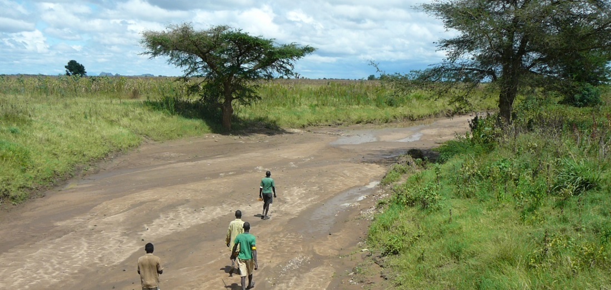
GIS and Remote Sensing for overlay analysis
March 24, 2022
Training Day 3
PM / Automation of GW suitability mapping
Dr. Maarten Waterloo
www.acaciawater.com

Slide 2
Training program
Day | Program of activities (AM/PM)
Day 1 Tue., March 22nd | Introduction to overlay analysis & QGIS / Input data processing (lithology, land use)
Day 2 Wed., March 23rd | Input data processing (recharge, TWI) / Input data processing (lineament proximity & density)
Day 3 Thu., March 24th | Suitability map generation / Automation of suitability mapping
Day 4 Fri., March 25th | Suitability map styling / Introduction to Google Earth Engine
Day 5 Sat., March 26th | Introduction to Python

Slide 3
Detailed program – Day 3
Time | Activities
9:00 – 12:00 | Generation of a groundwater suitability map
12:00 – 13:00 | LUNCH BREAK
13:00 – 14:20 | Introduction to automation in QGIS
15:40 – 16:00 | Automation of groundwater suitability mapping

Slide 4
Part 1
Automation in QGIS

Slide 5
Automation in QGIS
Batch processing
Graphical Modeler
Processing script

Slide 6
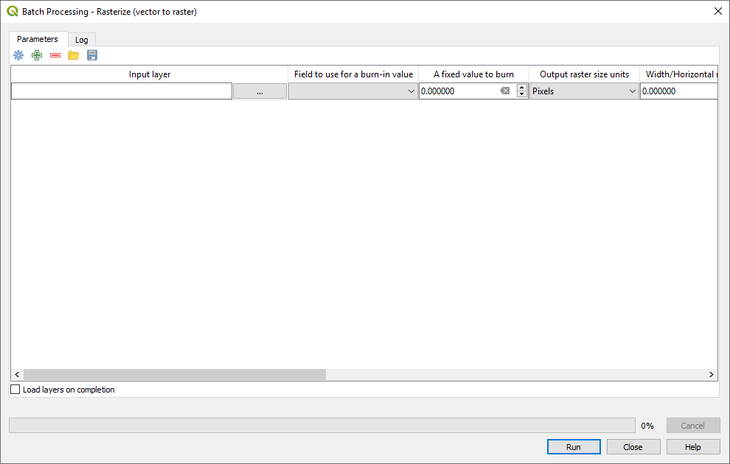
1. Batch processing

Slide 7
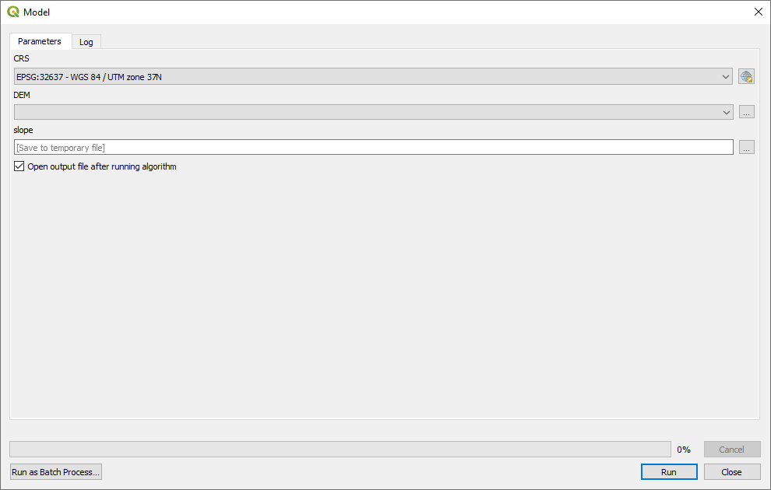
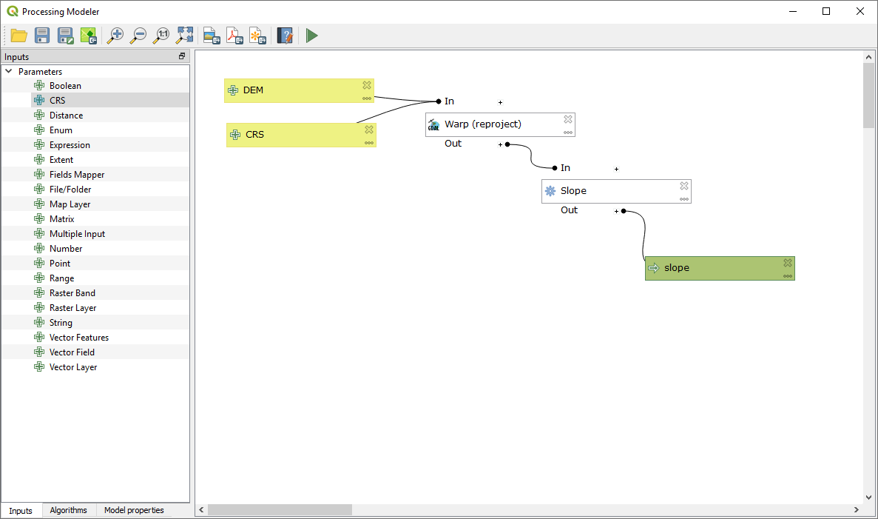
2. Graphical Modeler

Slide 8
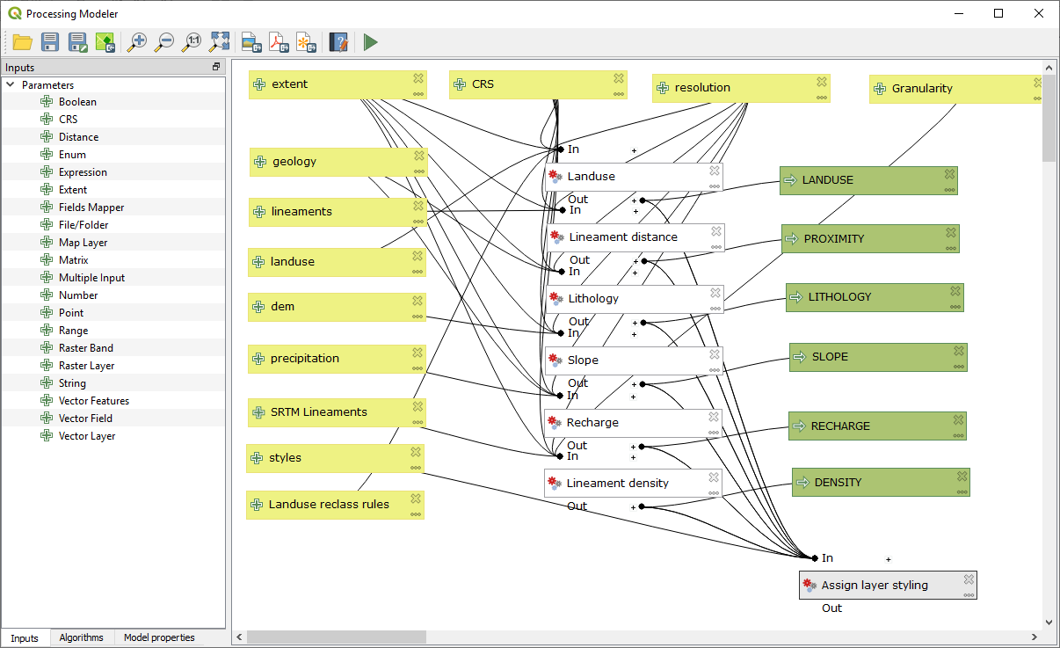
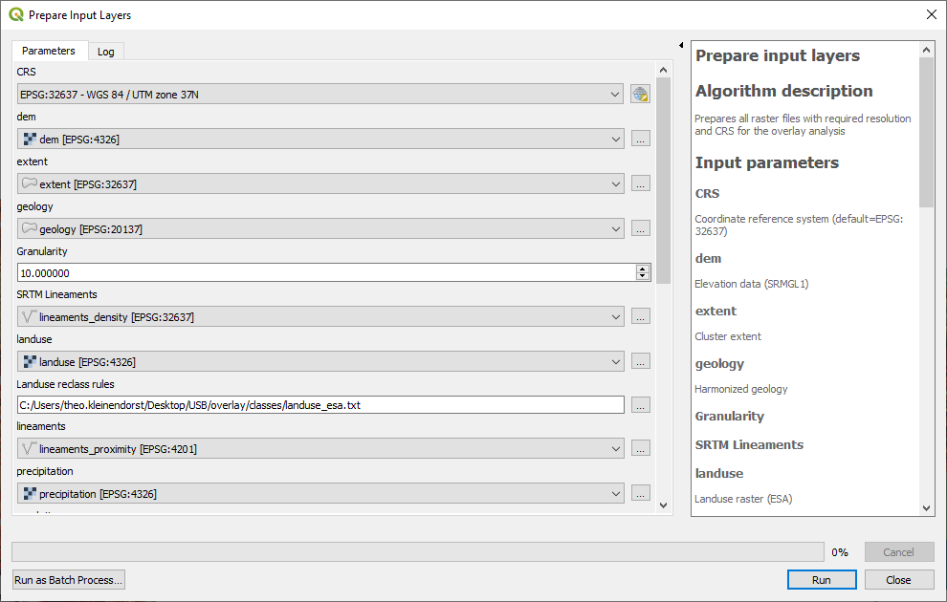
Prepare all overlay layers

Slide 9
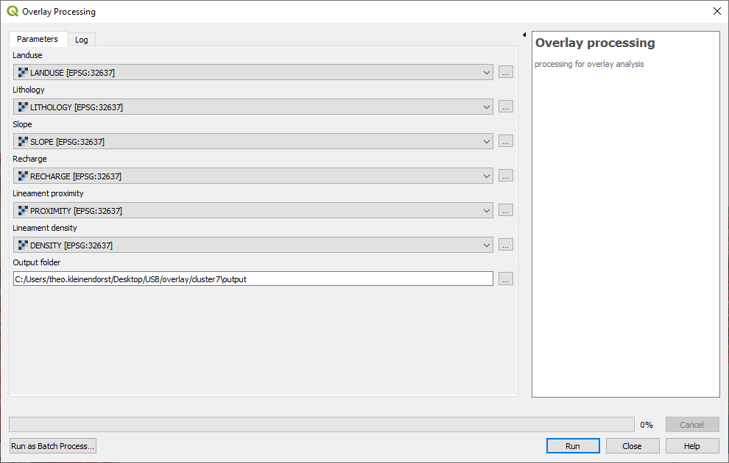
3. Processing script (python)

Slide 10
Part 2
Automation of groundwater suitability mapping

Slide 11
Automated overlay analysis and GW suitability mapping
Load QGIS project from cluster folder
Delete existing layers from LAYERS group (if any)
Select LAYERS group
Run model “Prepare input layers”
‘lineaments’ are the geological lineaments for proximity
‘SRTM lineaments’ are the lineaments for density based on the DEM and hillshade
Delete existing layers from OUTPUT group (if any)
Run script “Overlay processing”
Load suitability raster from output folder
Style suitability raster with standard style

Slide 12
Thank you for your attention
February 26, 2019
van Hogendorpplein 4, 2805 BM Gouda, the Netherlands
telephone: +31 (0)182 - 686 424
info@acaciawater.com | www.acaciawater.com

