Slide 1

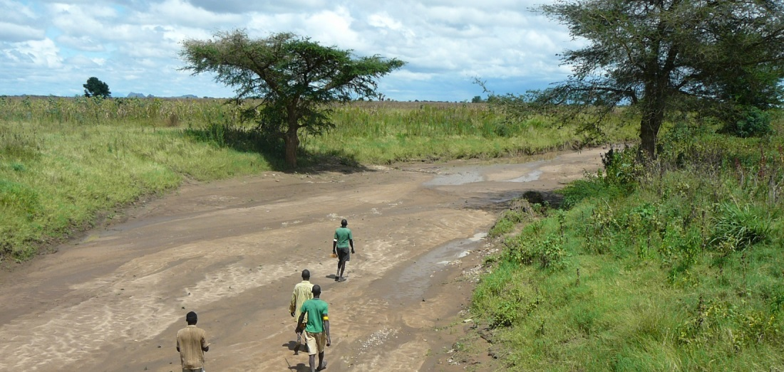



GIS and Remote Sensing for overlay analysis
March 24, 2022
Training Day 3
AM / Generation of groundwater suitability map
Dr. Maarten Waterloo
www.acaciawater.com

Slide 2
Training program
Day | Program of activities (AM/PM)
Day 1 Tue., March 22nd | Introduction to overlay analysis & QGIS / Input data processing (lithology, land use)
Day 2 Wed., March 23rd | Input data processing (recharge, TWI) / Input data processing (lineament proximity & density)
Day 3 Thu., March 24th | Suitability map generation / Automation of suitability mapping
Day 4 Fri., March 25th | Suitability map styling / Introduction to Google Earth Engine
Day 5 Sat., March 26th | Introduction to Python

Slide 3
Detailed program – Day 3
Time | Activities
9:00 – 12:00 | Generation of a groundwater suitability map
12:00 – 13:00 | LUNCH BREAK
13:00 – 14:20 | Introduction to automation in QGIS
15:40 – 16:00 | Automation of groundwater suitability mapping

Slide 4
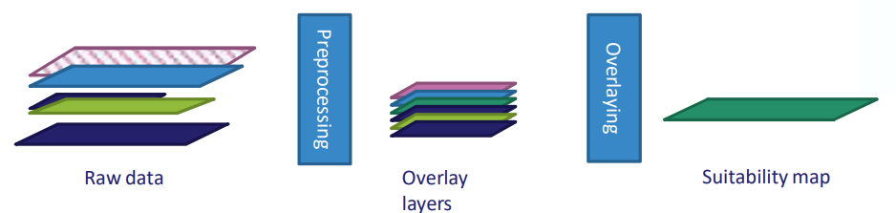
Overlay analysis - Workflow
STEP 0: Data acquisition and basic processing
STEP 1: Pre-processing
  > Clip, resample, reproject, classify, calculate
STEP 2: Overlaying
  > Classes and scores, weights, average suitability
STEP 3: Sensitivity analysis

Slide 5
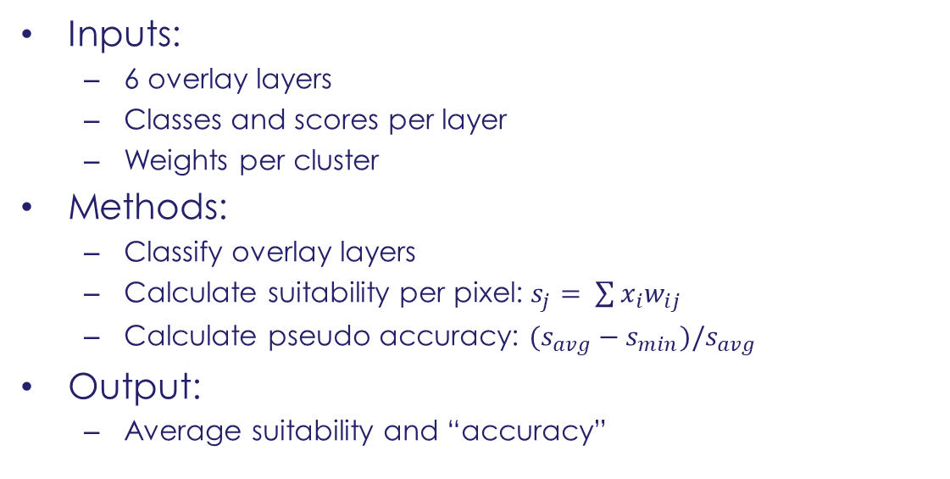
Step 2 - Principle
Inputs:
  6 overlay layers
  Classes and scores per layer
  Weights per cluster
Methods:
  Classify overlay layers
  Calculate suitability per pixel: $s_{j}= \sum{x_{i}w_{ij}}$
  Calculate pseudo accuracy: $(s_{avg}−s_{min})/s_{avg}$
Output:
  Average suitability and “accuracy”

Slide 6
Overlay 1
Score the input layers between 0 and 1
  Lithology (7 classes)
  Land use (5 classes)
  Slope (degree, 4 classes)
  Recharge (mm/y, 4 classes)
  Lineament density (km/km², 5 classes)
  Lineament proximity (distance in m, 5 classes)
{

Slide 7
Overlay 1 – Classes and scores
Slope | score
0 - 3 | 0.6
3 - 5 | 0.3
5 - 15 | 0.1
> 15 | 0.0
Lithology class | score
Loose Quaternary sediments | 0.250
Rift pyroclastics | 0.100
Upper basalts | 0.350
Lower basalts | 0.150
Mesozoic sediments | 0.050
Low grade basement | 0.075
High grade basement | 0.025
Land use | score
Crop land | 0.44
Bush, rangeland | 0.29
Forest | 0.17
Bare soil | 0.07
Urban | 0.03

Slide 8
Overlay 1 – Classes and scores
Lineament proximity | score
<500 | 0.62
500 – 1000 | 0.16
1000 – 2000 | 0.11
2000 – 4000 | 0.07
>4000 | 0.04
Recharge | score
<25 | 0.05
25 – 50 | 0.11
50 – 100 | 0.27
> 100 | 0.57
Lineament density | score
<0.3 | 0.03
0.3 – 0.6 | 0.07
0.6 – 0.9 | 0.15
0.9 – 1.2 | 0.30
> 1.2 | 0.45

Slide 9
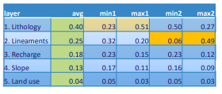
Overlay 2 - Weights
Notes:
???

Slide 10
Overlay 3 - Calculations
Calculate lineament score
  Density * 0.8 + Proximity * 0.2
Calculate suitability score
  Sum of (layer score) x (layer weight)

Slide 11
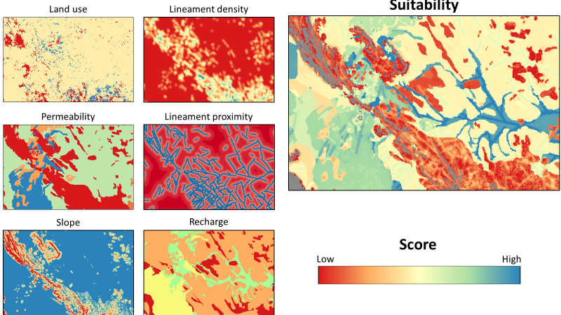
Overlay analysis - Result

Slide 12
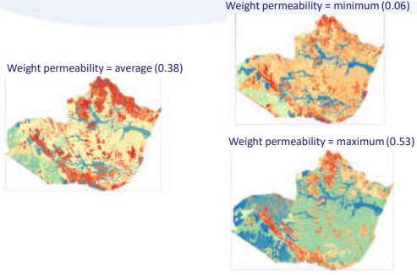
Effect of weight

Slide 13
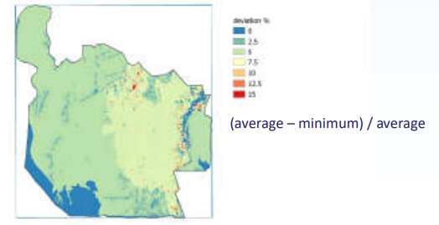
Accuracy

Slide 14


Thank you for your attention
February 26, 2019
van Hogendorpplein 4, 2805 BM Gouda, the Netherlands
telephone: +31 (0)182 - 686 424
info@acaciawater.com | www.acaciawater.com

