Slide 1
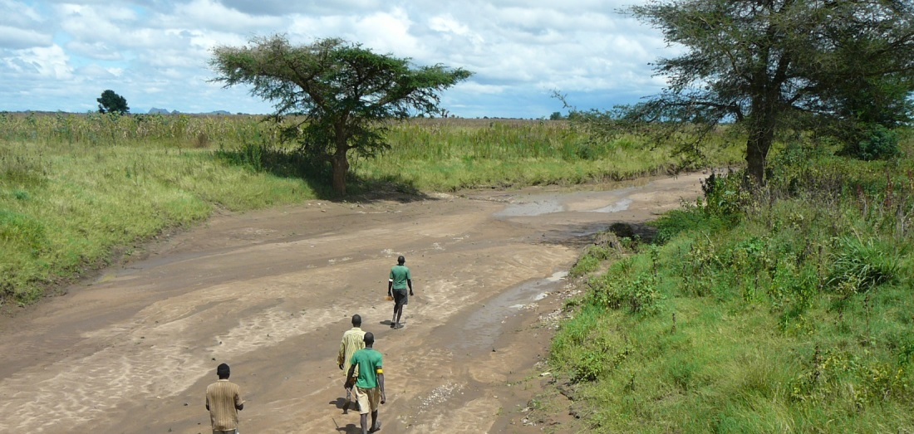
GIS and Remote Sensing for overlay analysis
March 23, 2022
Training Day 2
PM / Input data processing (3/3)
Dr. Maarten Waterloo
www.acaciawater.com

Slide 2
Training program
Day | Program of activities (AM/PM)
Day 1 Tue., March 22nd | Introduction to overlay analysis & QGIS / Input data processing (lithology, land use)
Day 2 Wed., March 23rd | Input data processing (recharge, TWI) / Input data processing (lineament proximity & density)
Day 3 Thu., March 24th | Suitability map generation / Automation of suitability mapping
Day 4 Fri., March 25th | Suitability map styling / Introduction to Google Earth Engine
Day 5 Sat., March 26th | Introduction to Python

Slide 3
Detailed program – Day 2
Time | Activities
9:00 – 12:00 | Input layer – Recharge (infiltration coefficient & precipitation)
 | Input layer – Topographic Wetness Index (TWI)
12:00 – 13:00 | LUNCH BREAK
13:00 – 13:20 | Introduction to lineament mapping
13:20 – 14:40 | Input layer – Lineament proximity
14:40 – 16:00 | Input layer – Lineament density

Slide 4
Overlay analysis - Workflow
STEP 0: Data acquisition and basic processing
STEP 1: Pre-processing
> Clip, resample, reproject, classify, calculate
STEP 2: Overlaying
> Classes and scores, weights, average suitability
STEP 3: Sensitivity analysis

Slide 5
Part 1
Lineament mapping

Slide 6
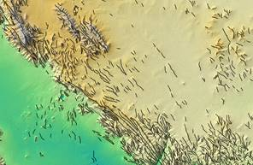
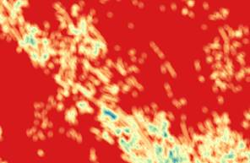
Lineament mapping from DEM

Slide 7
Lineament mapping
Based on elevation

Slide 8
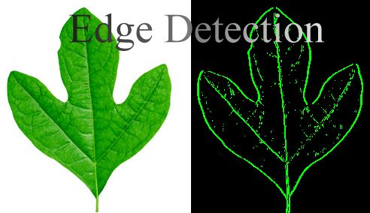
Lineament mapping – Principle

Slide 9
Lineament mapping – Result
(PCI Geomatica software)
Many lines: not only lineaments
High values in steep terrain
Underestimates lineaments in alluvial or regolith cover

Slide 10
Part 2
Pre-processing of lineament proximity layer

Slide 11
Pre-processing – Lineament proximity layer
Sources:
Lineaments from geological map
SRTM (by JRC using PCI Geomatics software)
(Landsat/Sentinel not usable due to vegetation cover)
Lineament proximity (m)
Class | Description
1 | < 500
2 | 500 – 1000
3 | 1000 – 2000
4 | 2000 - 4000
5 | > 4000

Slide 12
Lineament proximity layer - Procedure
Load extent (vector)
Load lineament map
Reproject lineament to UTM37N map if necessary > Reproject
Rasterize lineament map with 100m pixels > Rasterize
Calculate proximity raster in m > Proximity
Reclassify lineament proximity to 5 classes > (Tool/Mehod?)

Slide 13
Lineament proximity layer - Calculation
Geological map
Proximity in m

Slide 14
Part 3
Pre-processing of lineament density layer

Slide 15
Pre-processing – Lineament density layer
Sources:
Lineaments from geological map
SRTM (by JRC using PCI Geomatics software)
(Landsat/Sentinel not usable due to vegetation cover)
Lineament density (km/km2)
Class | Description
1 | < 0.3
2 | 0.3 – 0.6
3 | 0.6 – 0.9
4 | 0.9 – 1.2
5 | > 1.2

Slide 16
Lineament density layer – Procedure
Load the lineaments_density layer
Load the extent (UTM)
Check projection (should be WGS 84 UTM 37N, otherwise use Reproject tool)
Place points along lines > Points along geometry, with distance = 25m
Make raster density map > v.kernel.rast, with: radius = 1000; multiply density by = 10000 node method = split; kernel function = uniform
Resample the kernel raster to 100 m > Warp
Reclassify lineament density to 5 classes > (Tool/Mehod?)

Slide 17
Lineament density layer – Calculation

Slide 18
Thank you for your attention
February 26, 2019
van Hogendorpplein 4, 2805 BM Gouda, the Netherlands
telephone: +31 (0)182 - 686 424
info@acaciawater.com | www.acaciawater.com

