Slide 1
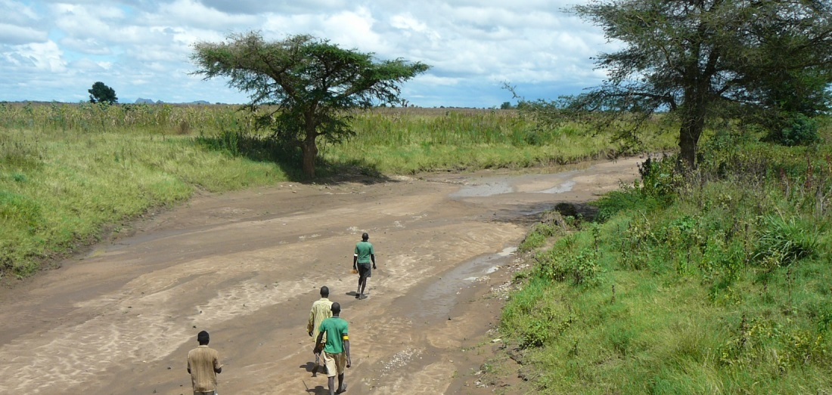
GIS and Remote Sensing for overlay analysis
March 23, 2022
Training Day 2
AM / Input data processing (2/3)
Dr. Maarten Waterloo
www.acaciawater.com

Slide 2
Training program
Day | Program of activities (AM/PM)
Day 1 Tue., March 22nd | Introduction to overlay analysis & QGIS / Input data processing (lithology, infiltration coefficient)
Day 2 Wed., March 23rd | Input data processing (GW recharge, TWI, land use) / Input data processing (lineament proximity & density)
Day 3 Thu., March 24th | Introduction to automation processes / Suitability map generation
Day 4 Fri., March 25th | Suitability map styling / Introduction to Google Earth Engine
Day 5 Sat., March 26th | Introduction to Python

Slide 3
Detailed program – Day 2
Time | Activities
9:00 – 12:00 | Input layer – Recharge (infiltration coefficient & precipitation)
 | Input layer – Topographic Wetness Index (TWI)
12:00 – 13:00 | LUNCH BREAK
13:00 – 14:20 | Input layer – Lineament proximity
15:40 – 16:00 | Input layer – Lineament density

Slide 4
Overlay analysis - Workflow
STEP 0: Data acquisition and basic processing
STEP 1: Pre-processing
> Clip, resample, reproject, classify, calculate
STEP 2: Overlaying
> Classes and scores, weights, average suitability
STEP 3: Sensitivity analysis

Slide 5
Part 1
Pre-processing of recharge layer

Slide 6
Pre-processing – Recharge layer
Source:
Harmonized geological map
Precipitation (CHIRPS 2000-2014, annual mean)
Infiltration coefficient, assigned to every lithological unit (BRGM 1998, Abbay basin)
R = P * IC (mm/y)
Class | Description
1 | < 25
2 | 25 – 50
3 | 50 – 100
4 | > 100

Slide 7
Infiltration coefficient layer – Procedure
Load woreda extent (vector)
Load harmonized geological map (vector)
Load infiltration coefficients (delimited text)
Join table with infiltration coefficients to map using “code” column > Double click on layer name, then go to Joins menu
If joined field is a string (aligned left), then change to number (aligned right) > Field calculator
Rasterize map using infiltration coefficient, set resolution to 100m and extent to woreda extent > Rasterize

Slide 8
Recharge layer - Procedure
Load extent (vector)
Load infiltration coefficients (raster)
Load precipitation (raster)
Resample precipitation to 100m pixels and clip to extent > Warp
Multiply precipitation with infiltration coefficient and save as recharge > Raster calculator, using equation P * IC
Reclassify recharge to 4 classes > (Tool/Mehod?)

Slide 9
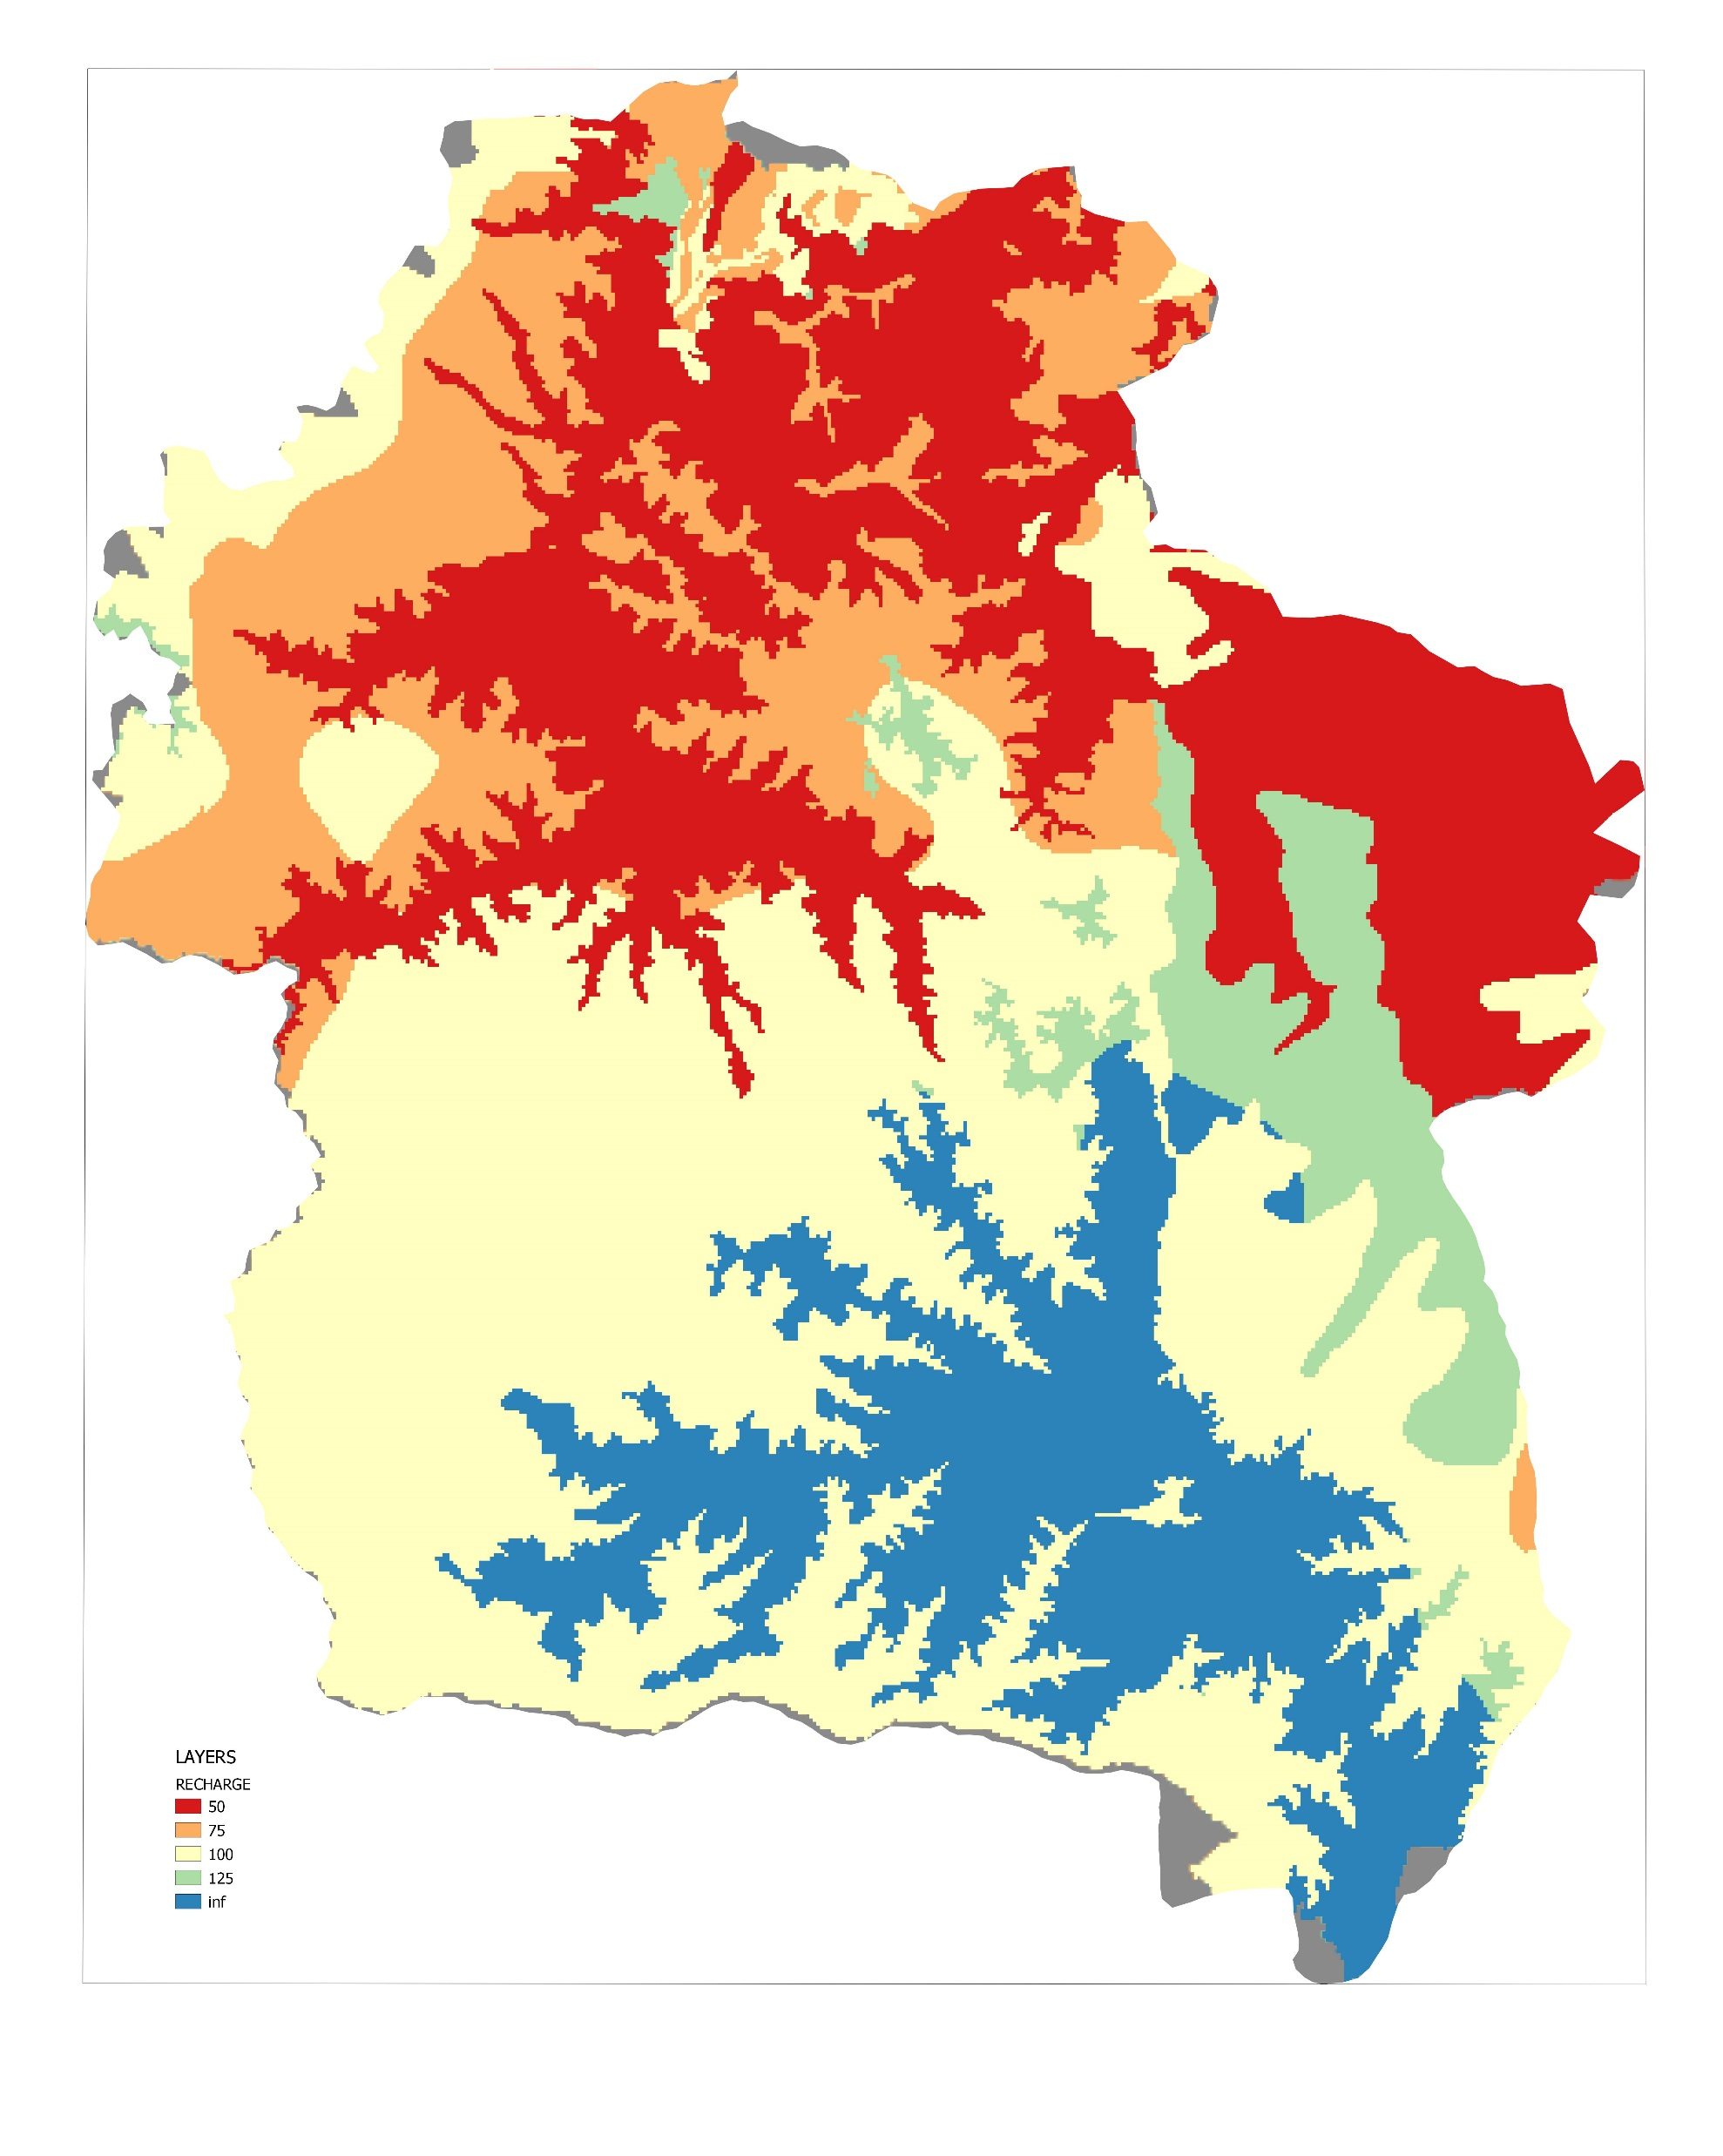
Recharge - Calculation
Precipitation (600-1000 mm/y)
Recharge (50-150 mm/y)

Slide 10
Part 2
Pre-processing of TWI layer

Slide 11
Pre-processing – Slope layer
Source: SRTMGL1 (30m)
Standard QGIS toolbox
Class | Description
1 | 0 – 3
2 | 3 – 5
3 | 5 – 15
4 | > 15

Slide 12
Slope layer – Procedure
Load extent (vector)
Load Digital Elevation Model (raster)
Reproject DEM to UTM37N, WGS84 with resolution 100m and clip to extent > Reproject
Calculate slope > r.watershed
Reclassify slope to 4 classes > (Tool/Method?)

Slide 13
Slope layer - Calculation

Slide 14
Thank you for your attention
February 26, 2019
van Hogendorpplein 4, 2805 BM Gouda, the Netherlands
telephone: +31 (0)182 - 686 424
info@acaciawater.com | www.acaciawater.com

