Slide 1
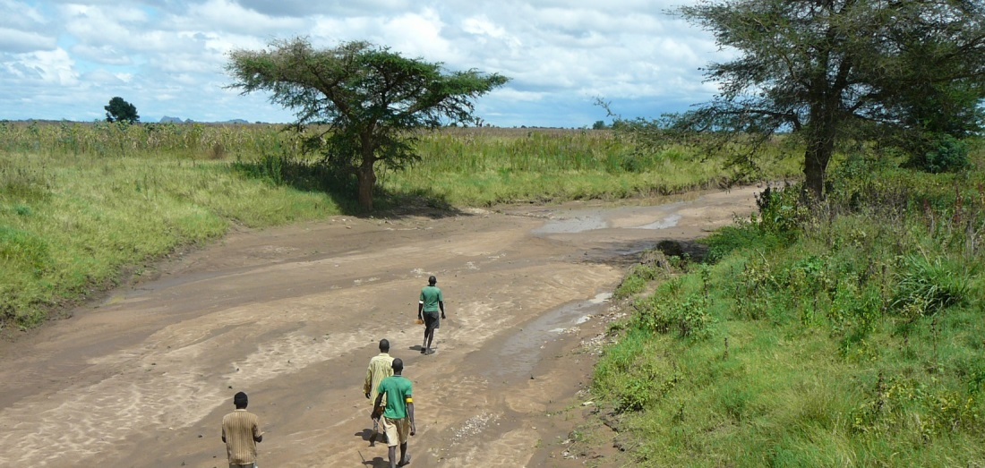
GIS and Remote Sensing for overlay analysis
March 22, 2022
Training Day 1
PM / Input data processing (1/3)
Dr. Maarten Waterloo
www.acaciawater.com

Slide 2
Training program
Day | Program of activities (AM/PM)
Day 1 Tue., March 22nd | Introduction to overlay analysis & QGIS / Input data processing (lithology, land use)
Day 2 Wed., March 23rd | Input data processing (recharge, TWI) / Input data processing (lineament proximity & density)
Day 3 Thu., March 24th | Suitability map generation / Automation of suitability mapping
Day 4 Fri., March 25th | Suitability map styling / Introduction to Google Earth Engine
Day 5 Sat., March 26th | Introduction to Python

Slide 3
Detailed program – Day 1
Time | Activities
9:00 – 12:00 | Introduction to GIS
 | Introduction to overlay analysis
 | Introduction to QGIS
12:00 – 13:00 | LUNCH BREAK
13:00 – 16:00 | Overlay analysis – Step 1
 | Input layer – Lithology
 | Input layer – Land use

Slide 4
Overlay analysis - Workflow
STEP 0: Data acquisition and basic processing
STEP 1: Pre-processing
> Clip, resample, reproject, classify, calculate
STEP 2: Overlaying
> Classes and scores, weights, average suitability
STEP 3: Sensitivity analysis

Slide 5
Part 1
Introduction of Overlay Analysis – Step 1

Slide 6
Step 1 – Principle
Output:
Overlay layers with uniform resolution, extent and CRS: lithology, land use, recharge, slope, lineaments (x2)
Input:
CRS (WSG84, UTM 37N), resolution (100 m)
Input maps: extent, lithology, DEM, land use, lineaments (x2), precipitation, evapotranspiration
Look-up tables (lithology and land use classes)
Style definitions

Slide 7
Step 1 – Input data
Primary data:
Lithology
Recharge
Land use
Slope/Topographic Wetness Index (TWI)
Lineaments
Secondary data:
Evapotranspiration
Vegetation Index
Soil moisture
Hydrology (catchments, drainage network, wetness index)

Slide 8
Step 1 – Main geo-algorithms
Clipping to cluster extent
Reprojection and resampling (average or mode) to desired resolution
Calculation (recharge, slope, density, proximity)
Classification (lithology, land use)

Slide 9
Geo-algorithms – Clipping

Slide 10
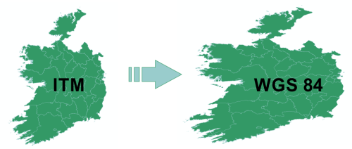
Geo-algorithms – Reproject

Slide 11
Geo-algorithms – Resample

Slide 12
Geo-algorithms – Join
Shapefile
Excel/csv/txt
Infiltration coefficient
+
=

Slide 13
Geoalgorithms – Rasterize

Slide 14
Geo-algorithms – Calculation
Field calculator
Raster calculator
Graphical modeler

Slide 15
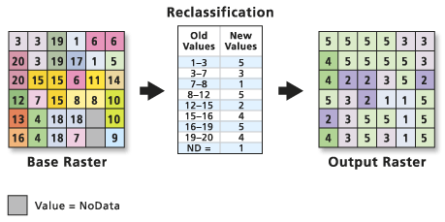
Geo-algorithms – Reclassify

Slide 16
Part 2
Pre-processing of lithology layer

Slide 17
Pre-processing – Lithology layer
Source: Harmonized geological map
Classification: from 104 => to 7 classes
Class | Description
1 | Loose quaternary sediments, including elluvials and Miocene sediments
2 | Rift pyroclastics and rift silicics
3 | Upper basalts + Quaternary highland basalts + Rift basalts
4 | Lower basalts
5 | Limestone + Upper sandstone + Shale + Marl + all other Mesozoics
6 | Low grade basement and Adigrate sandstone
7 | High grade basement

Slide 18
Lithology layer – Procedure
Load woreda extent (vector)
Load harmonized geological map (vector)
Load lithology classes (delimited text)
Join table with classes to map using “code” column
> Double click on layer name, then go to Joins menu
If joined field is a string (aligned left), then change to number (aligned right) > Field calculator
Reproject map to UTM37N, WGS84 (EPSG:32637) > Warp
Rasterize reprojected map using 7 classes, set resolution to 100m and extent to woreda extent > Rasterize

Slide 19
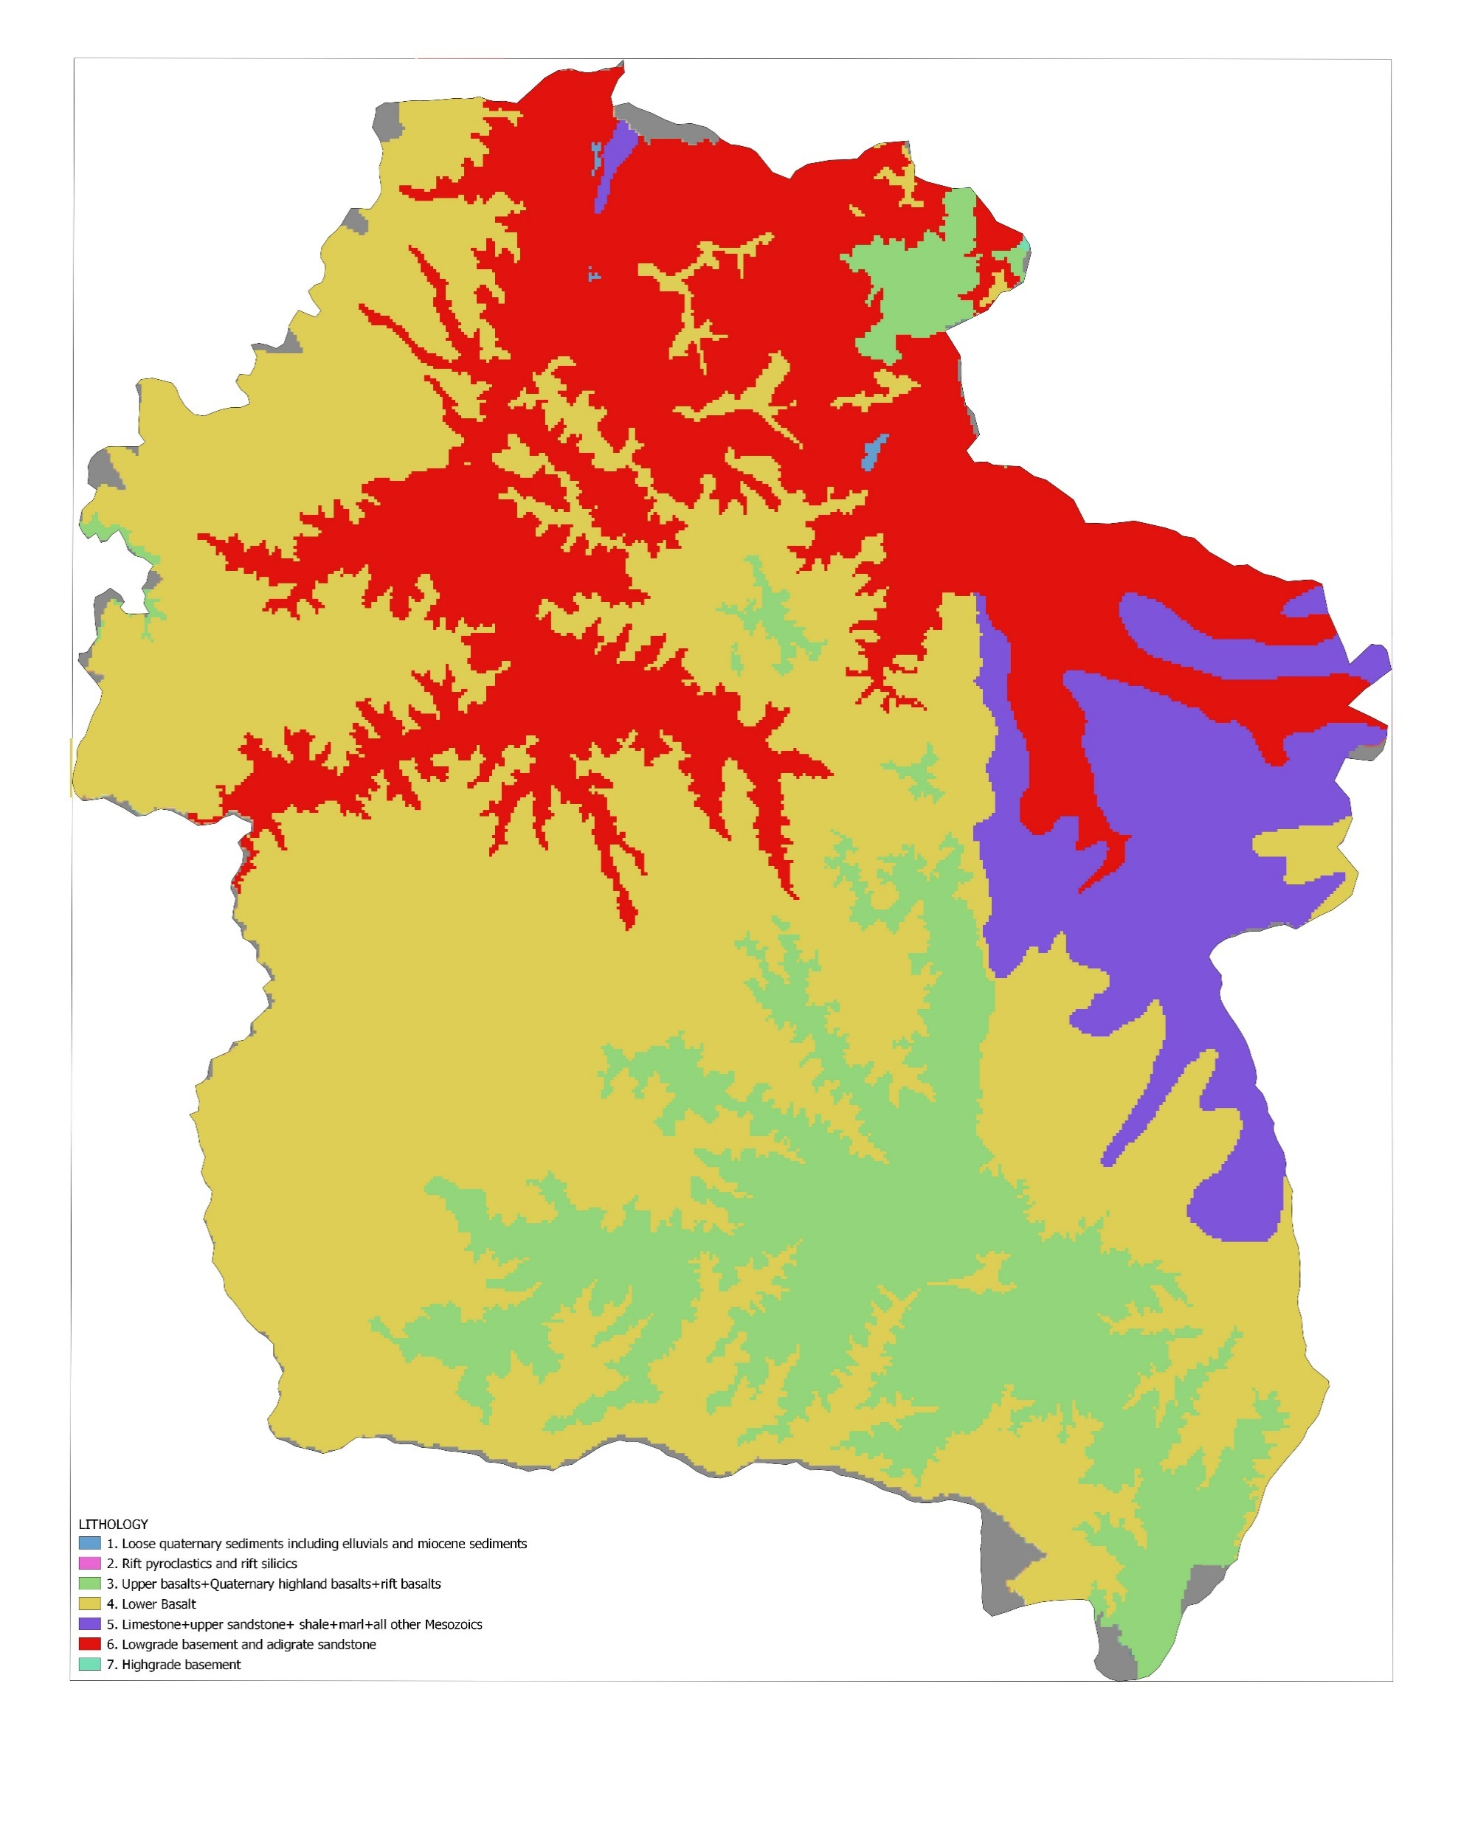
Lithology layer – Classification
Harmonized geological map
7 lithology classes

Slide 20
Part 3
Pre-processing of land use layer

Slide 21
Pre-processing – Land use
Source: 2016 Sentinel-2A imagery (20 m)
Reclassification into 5 classes
Class | Description
1 | Cropland
2 | Bush and rangeland
3 | Forest
4 | Bare soil and degraded land
5 | Urban area

Slide 22
Land use layer – Procedure
Load extent (vector)
Load land use data (raster)
Reclassify landuse to 5 classes > r.reclass, using overlay/classes/landuse_esa.txt
Reproject and resample landuse to UTM37N, WGS84 with resolution 100m and clip to extent (think about resampling method to use) > Warp (Hint: use ‘Mode’ for resampling methods)

Slide 23
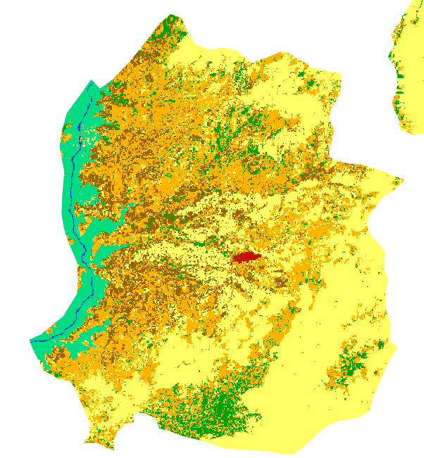
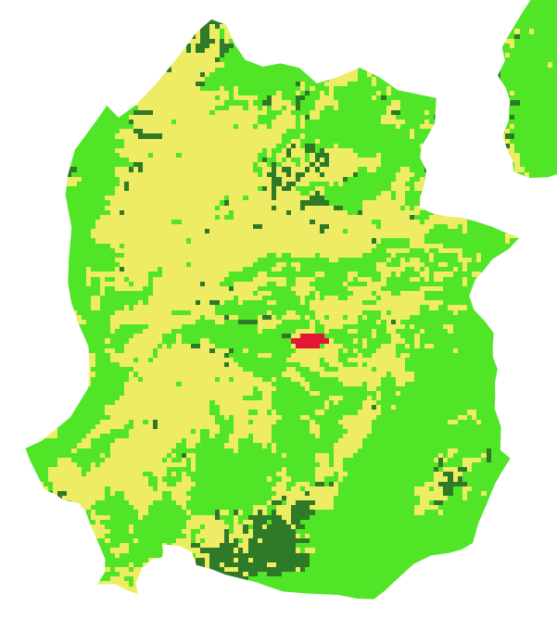
Land use layer – Reclassification
Land use ESA (20 m)
Reclassified land use (100 m)

Slide 24
Thank you for your attention
February 26, 2019
van Hogendorpplein 4, 2805 BM Gouda, the Netherlands
telephone: +31 (0)182 - 686 424
info@acaciawater.com | www.acaciawater.com

