Slide 1
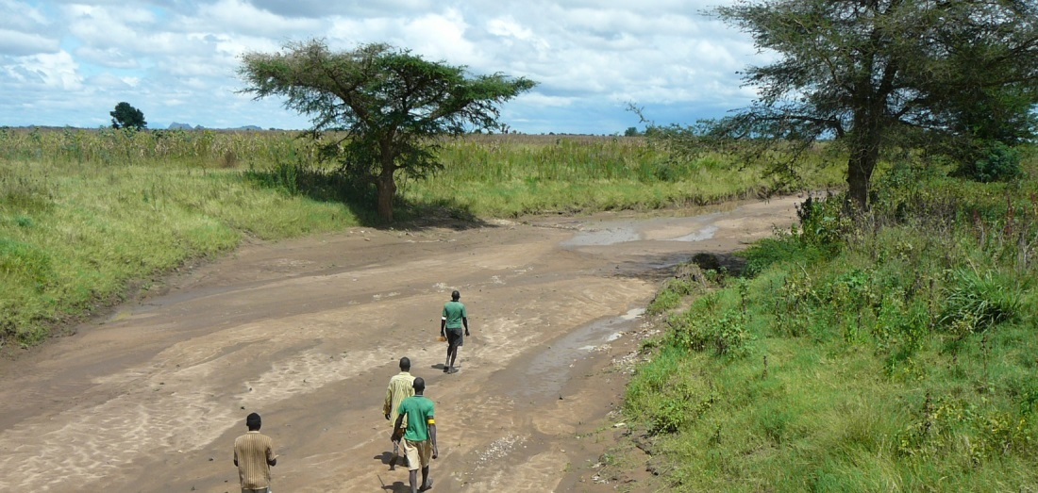
GIS and Remote Sensing for overlay analysis
March 22, 2022
Training Day 1 (AM)
/ Introduction to overlay analysis & QGIS
Dr. Maarten Waterloo
www.acaciawater.com

Slide 2
Training program
Day | Program of activities (AM/PM)
Day 1 Tue., March 22nd | Introduction to overlay analysis & QGIS / Input data processing (lithology, land use)
Day 2 Wed., March 23rd | Input data processing (recharge, TWI) / Input data processing (lineament proximity & density)
Day 3 Thu., March 24th | Suitability map generation / Automation of suitability mapping
Day 4 Fri., March 25th | Suitability map styling / Introduction to Google Earth Engine
Day 5 Sat., March 26th | Introduction to Python

Slide 3
Detailed program – Day 1
Time | Activities
9:00 – 12:00 | Introduction to GIS
 | Introduction to overlay analysis
 | Introduction to QGIS
12:00 – 13:00 | LUNCH BREAK
13:00 – 14:20 | Input layer – Lithology
15:40 – 16:00 | Input layer – Land use

Slide 4
PART 1
Introduction to GIS

Slide 5
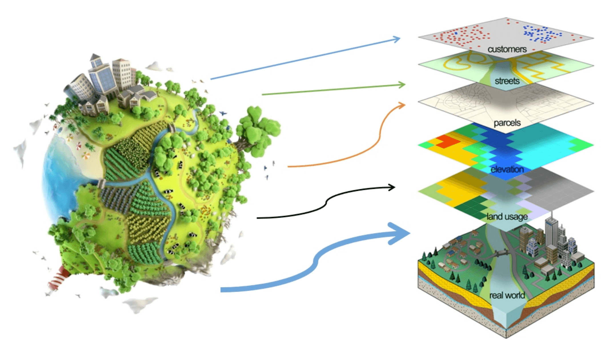
What is GIS?
Geographical Information System

Slide 6
Introducing GIS
Collection, storage, management and analysis of spatial environmental, demographic, and topographic data
→ Valuable insights and revealing visualizations
→ Help to make informed decisions
→ Various applications
For additional information:
https://docs.qgis.org/3.16/en/docs/gentle_gis_introduction/index.html#gentle-introduction-gis

Slide 7
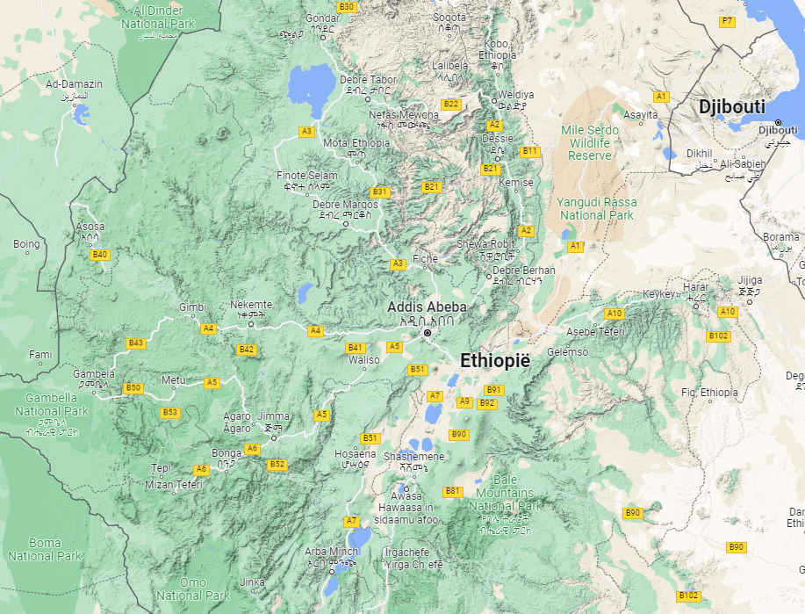
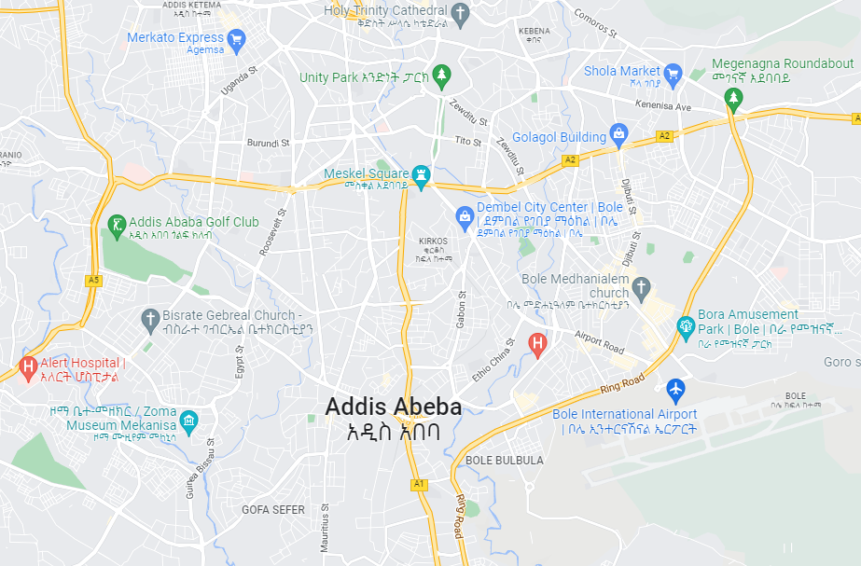
GIS applications (1/4)
Mapping
e.g. Google Maps (navigation purposes)

Slide 8
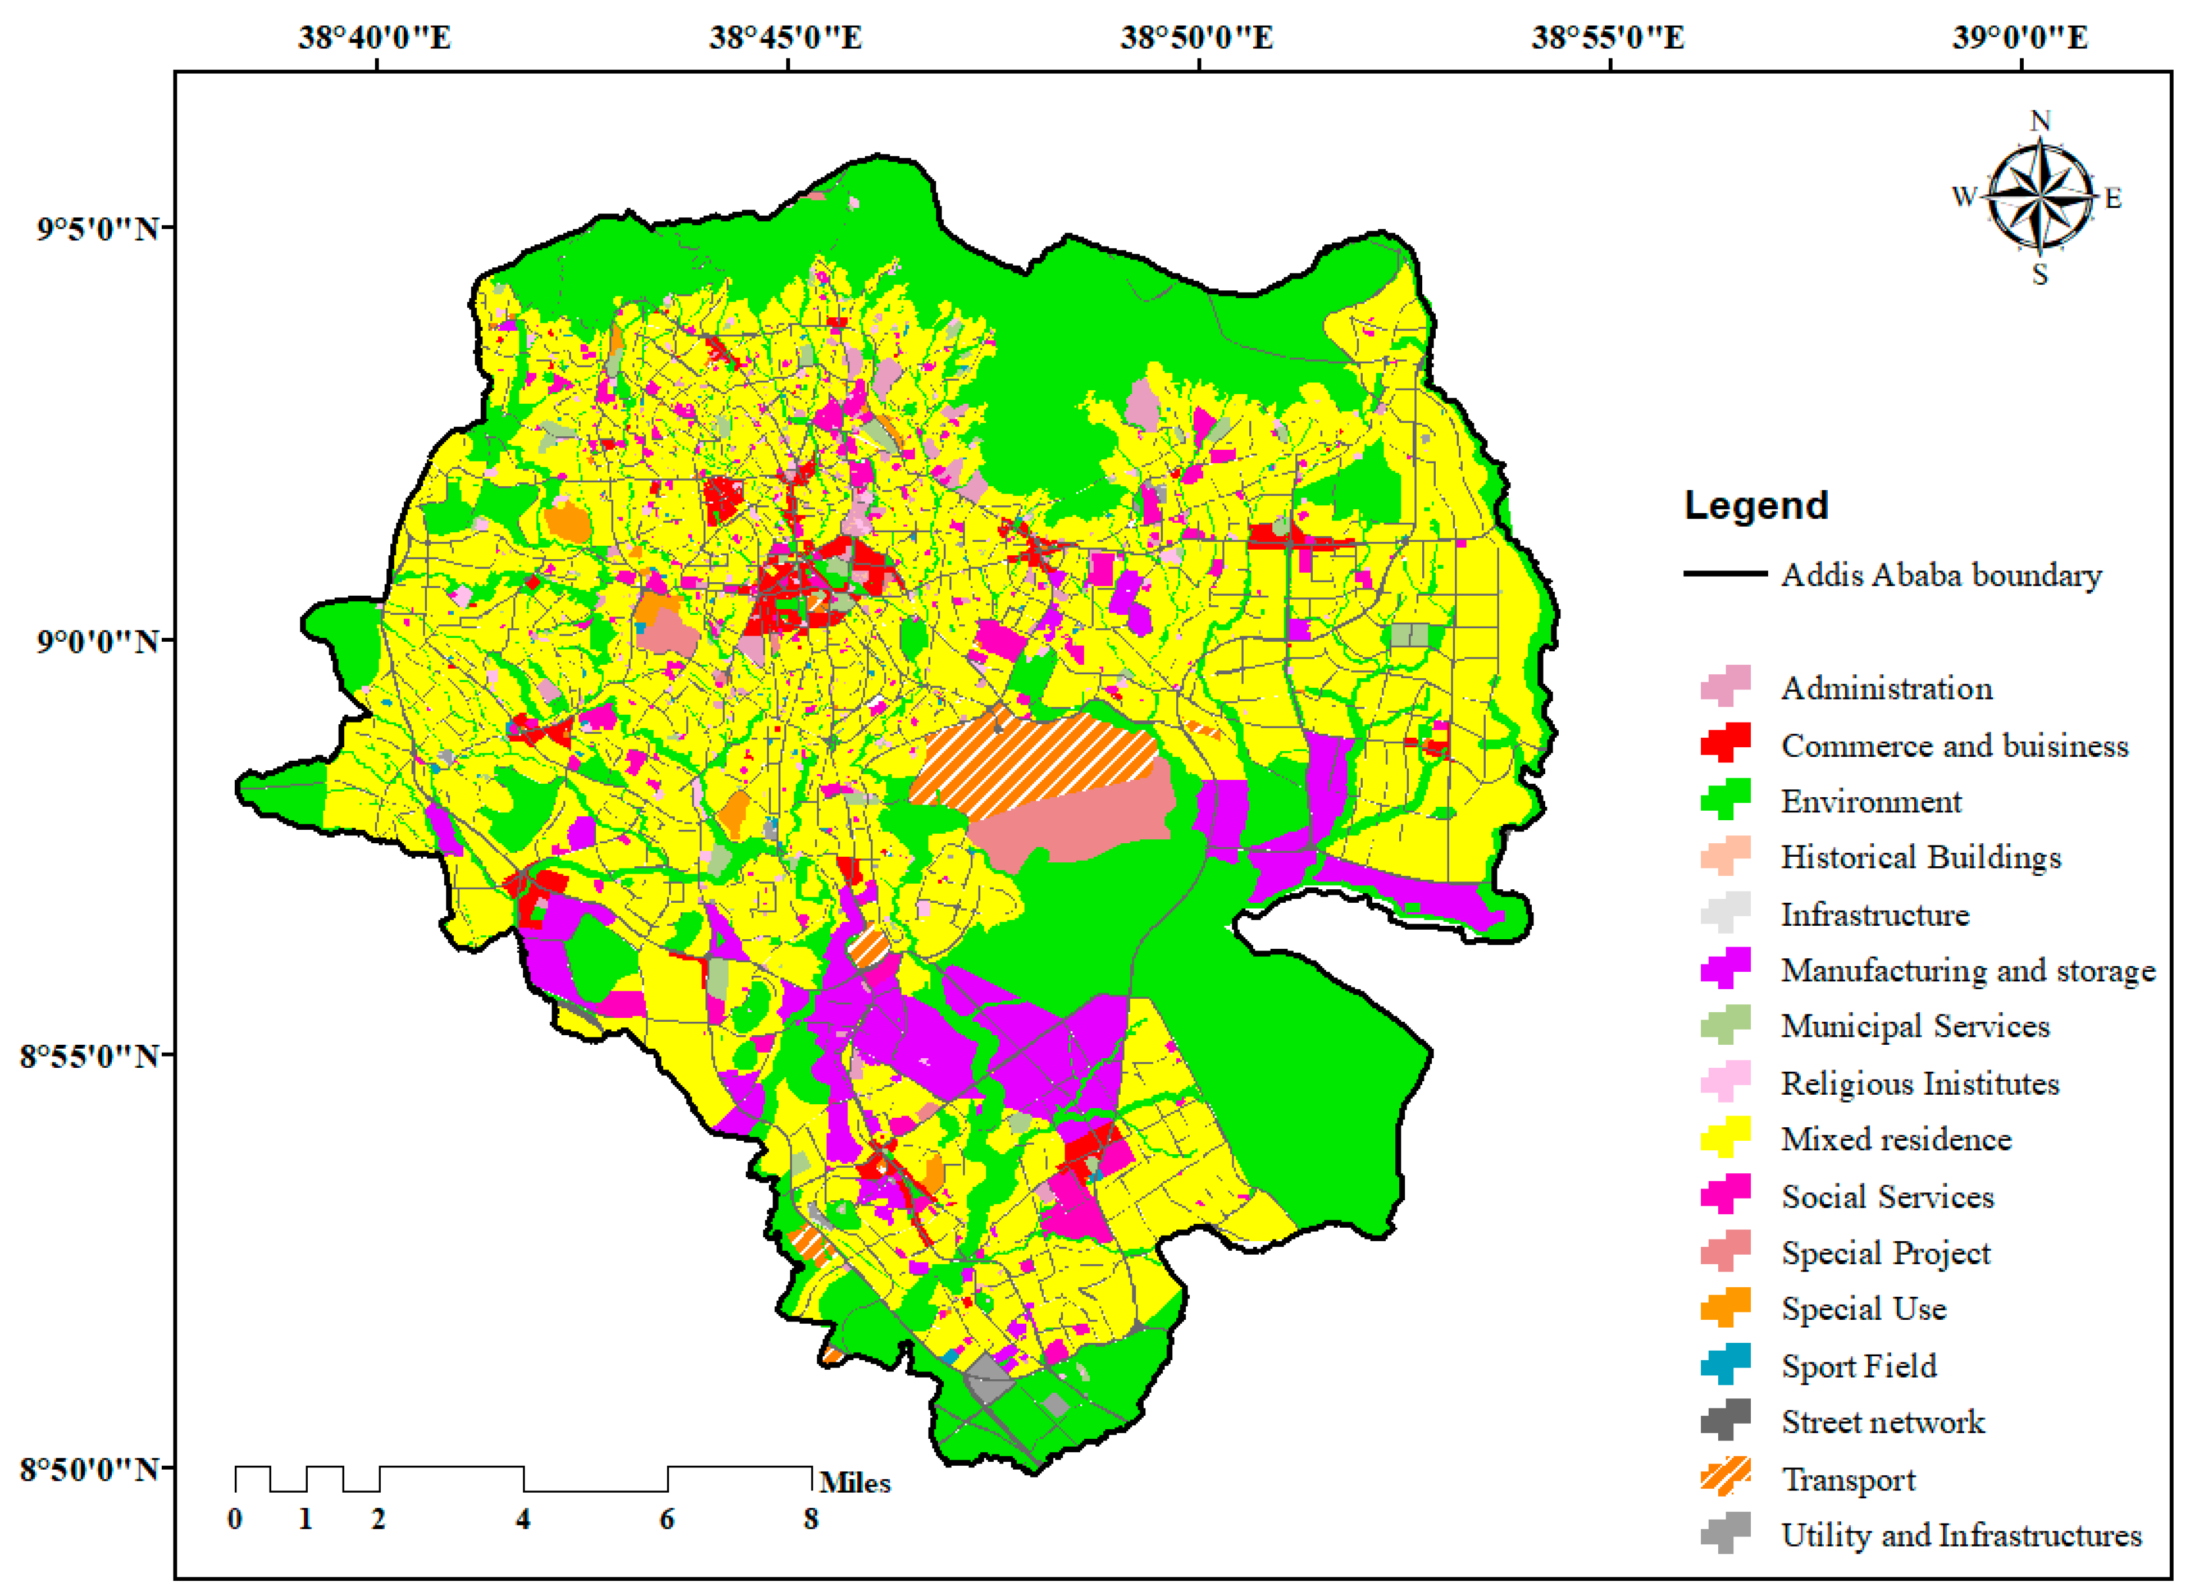
GIS applications (2/4)
Urban planning
e.g. designing and mapping of infrastructures and services, planning of urban growth
Notes:
https://www.mdpi.com/2073-445X/10/1/85/htm

Slide 9
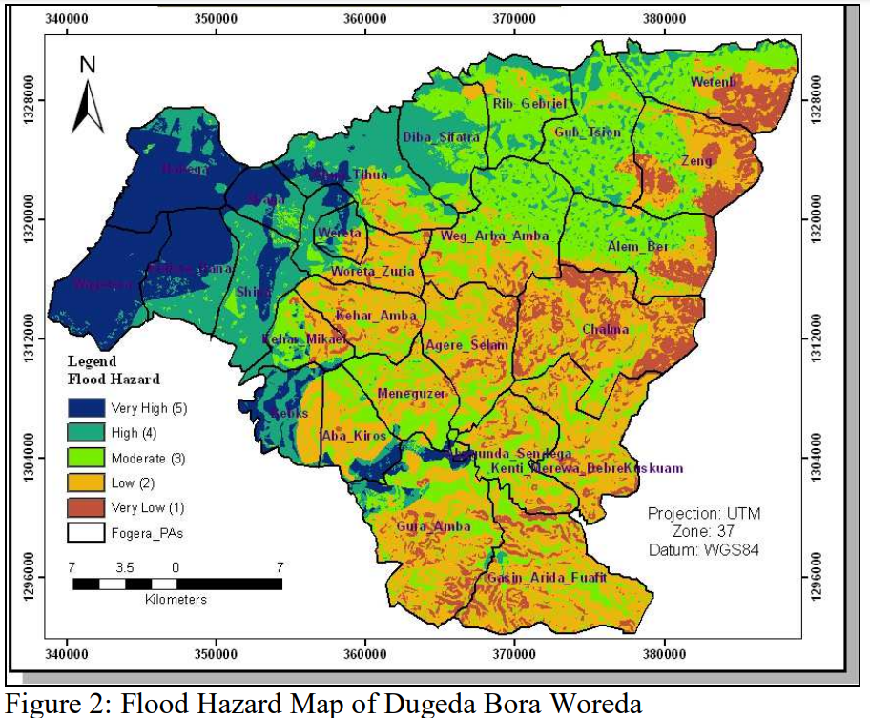
GIS applications (3/4)
Disaster response
e.g. mapping of floods, wildfires, etc.
Notes:
https://refubium.fu-berlin.de/bitstream/handle/fub188/19048/Belayneh-Application_of_GIS_and_Remote_Sensing_Techniques-244_001-Copy.pdf?sequence=1&isAllowed=y

Slide 10
GIS applications (4/4)
Agricultural value chain
e.g. analysis of soil data, yield predictions, assisting precision farming, etc.
Natural resource management
e.g. biodiversity hotspots, allocation and distribution of water and forests, etc.

Slide 11
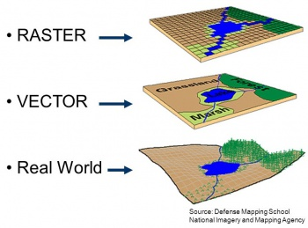
GIS data – Vector vs Raster

Slide 12
Spatial data acquisition
Direct acquisition (primary data)
Ground-based field survey data
Remotely sensed data from satellites, aircrafts or drones
Existing spatial data (secondary data)
Printed maps
Digitized data sets
Processed data from firms or international agencies
Notes:
Geological map boundaries → georeferencing (?)

Slide 13
Spatial data acquisition – Georeferencing

Slide 14
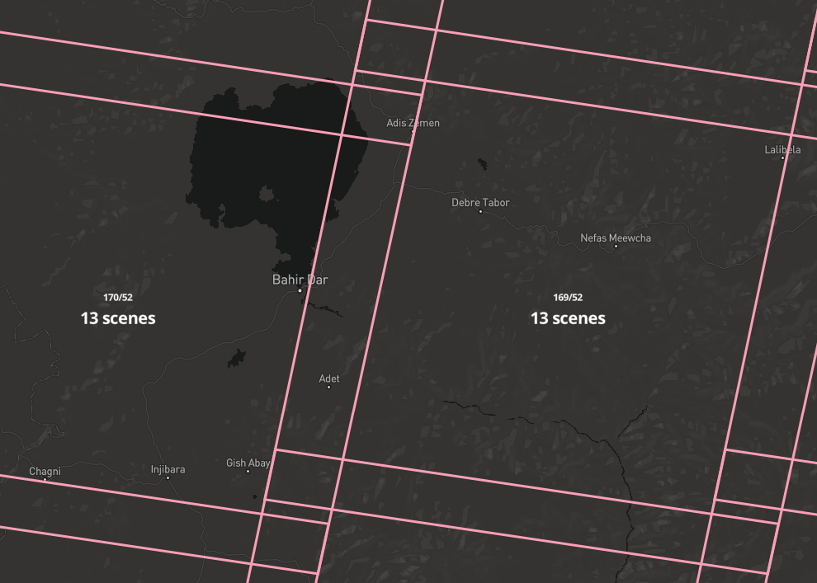
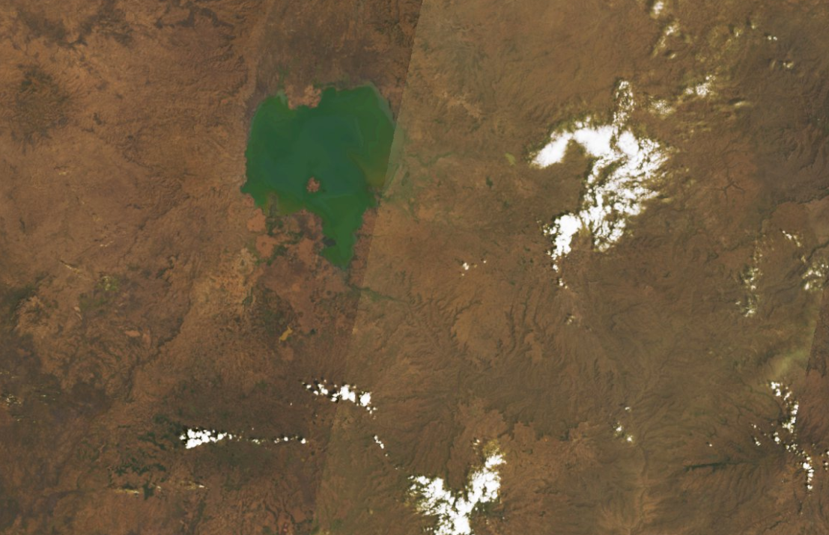
Spatial data acquisition – Satellite imagery & RS data
Landsat 9 OLI (Lake Tana, Oct 30th, 2021, to Feb 25th, 2022)
Landsat imagery
Landsat pixel (30x30 m)
Landsat scenes

Slide 15
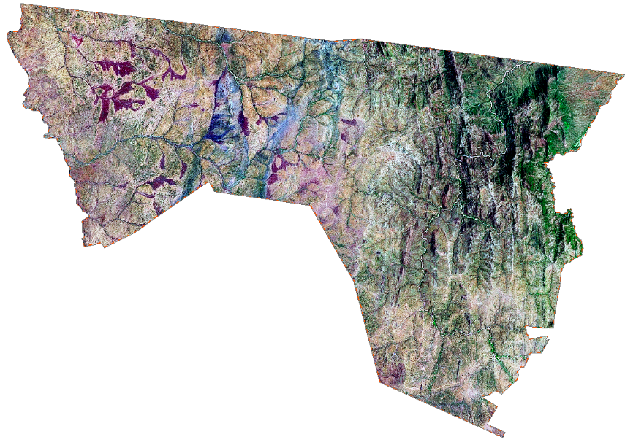
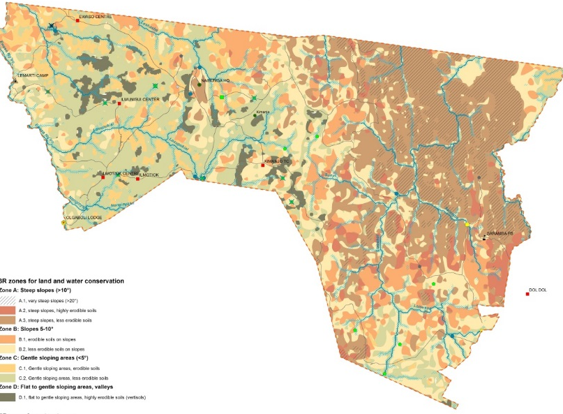
Spatial data acquisition – Satellite imagery & RS data
From satellite imagery to thematic maps
Classification
Landsat imagery
Thematic map

Slide 16
Vector data
Points
Lines
Polygons

Slide 17
Vector data – Attribute table
Points
Lines
Polygons
ID | Population | Region | Name
1 | 10346 | East
2 | 4503 | North
3 | 15950 | South

Slide 18
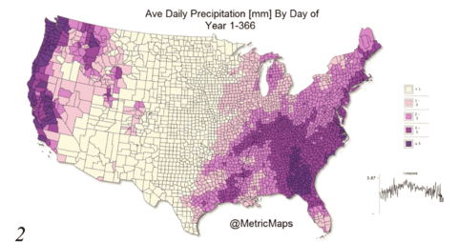
Vector data – Time series

Slide 19
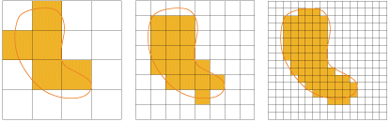
Raster data
Columns
Rows
Height
Width

Slide 20
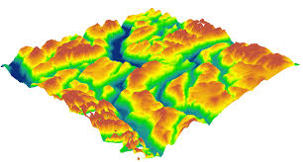
Raster data – Digital Elevation Model (DEM)
A representation of the bare ground (bare earth) topographic surface of the Earth, excluding trees, buildings, and any other surface objects

Slide 21
PART 2
Introduction to overlay analysis

Slide 22
Overlay analysis – Principle
Vector
Raster
Vector
Vector
Raster
Raster

Slide 23
Questions
What would be important spatial information to determine where to develop a waste dump?
And for groundwater suitability mapping?

Slide 24
Overlay analysis – GW suitability mapping
Inform decisions on siting of GW wells,
Combined with other socio-economic and environmental factors
Input layers
Lithology
Recharge
Land use
Slope / TWI (Topographic Wetness Index)
Lineament density
Lineament proximity
Notes:
Slope OR Topographic Wetness Index?

Slide 25
Overlay analysis - Workflow
STEP 0: Data acquisition and basic processing
STEP 1: Pre-processing
> Clip, resample, reproject, classify, calculate
STEP 2: Overlaying
> Classes and scores, weights, average suitability
STEP 3: Sensitivity analysis

Slide 26
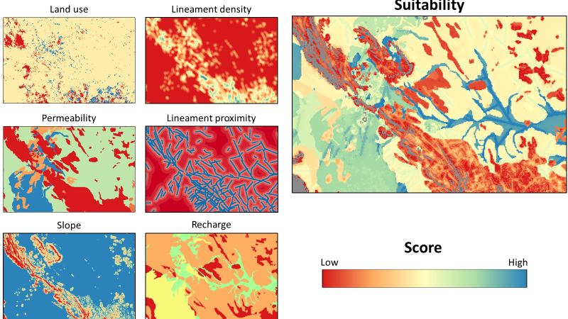
Overlay analysis - Result

Slide 27
Part 3
Introduction to QGIS

Slide 28
Why QGIS?
Powerful GIS used to process, analyse and display geographic information
100% Free and Open-source (FOSS)
Intuitive interface and customizable
Wide range of data and functionnalities
Active community of users (Esri, GISuser, GIS Lounge)
Free Qfield for offline use on tablets and phones
Notes:
For additional information:
https://docs.qgis.org/3.16/en/docs/training_manual/index.html

Slide 29
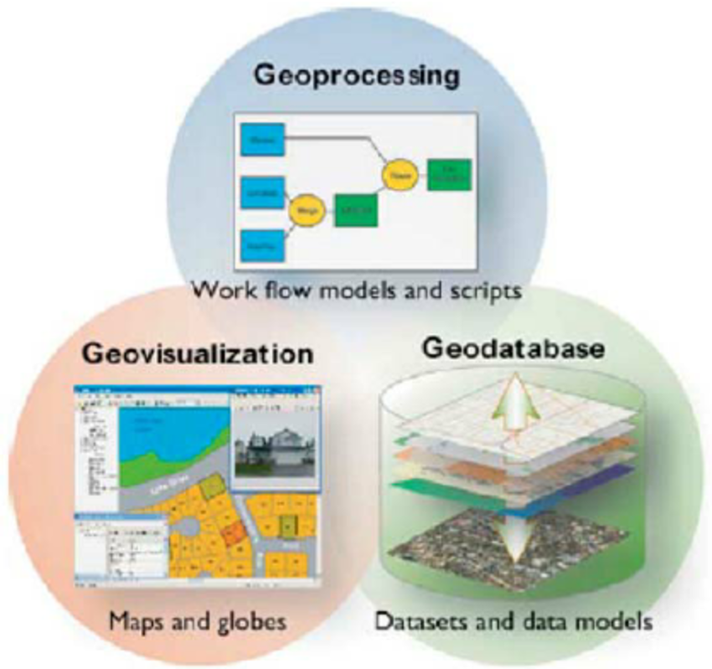
QGIS main functionnalities
Mapping
Data management
Geoprocessing

Slide 30
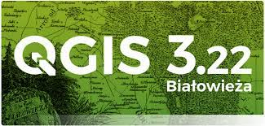
QGIS – Install software
QGIS Standalone Installer Version 3.22
Install from USB stick
OR
Download the QGIS installer at:
https://qgis.org/downloads/QGIS-OSGeo4W-3.22.4-1.msi

Slide 31
QGIS – Plugins
Many new features and functions can be easily added to the application
Written in Python
Execution of specific tasks
Useful plugins:
SRTM-Downloader, for elevation data
QSWAT3, for watershed hydrological modeling
GEE (Google Earth Engine)
Install from Plugins > Management, and > Install plugins
Notes:
For information

Slide 32
QGIS – Create a basic map (/)
Open a new GIS project
Directories
CRS

Slide 33
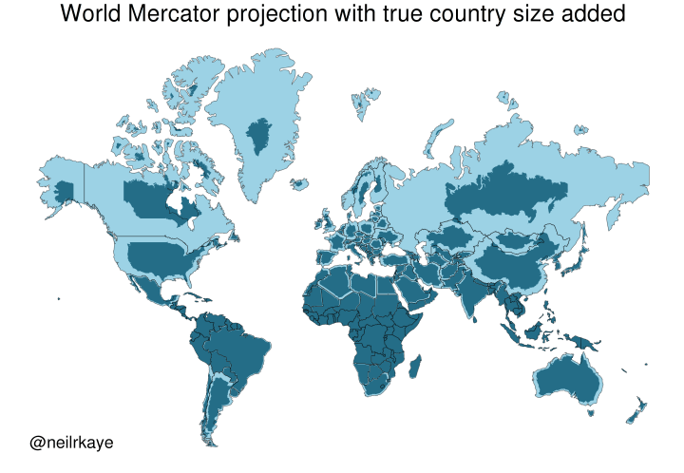
Projections

Slide 34
Overview of the interface
Notes:
Include caption

Slide 35
QGIS – Create a basic map (/)
Download input data
Searching for data
Data sources: Google Earth Engine, etc.
Key words on internet: using ‘dataset’ ‘data’ ‘database’ on ‘blabla’

Slide 36
QGIS – Create a basic map (/)
Adding vector layer
Attribute table
Symbology

Slide 37
QGIS – Create a basic map (/)
Adding raster layer
Symbology

Slide 38
QGIS – Layer styling

Slide 39
QGIS – Webservices
Data sources online from which you can load data as long as you are connected to the Internet
Web Mapping Services (WMS), a service hosted on a remote server which provides maps
Web Feature Services (WFS), which provides GIS data in formats that can be loaded directly in QGIS and edited
Relative to groundwater database platform:
https://mowe.acaciadata.com/
Notes:
For information
What servers done? How are they built? Check projects on QGIS

Slide 40
Thank you for your attention
March 22, 2022
van Hogendorpplein 4, 2805 BM Gouda, the Netherlands
telephone: +31 (0)182 - 686 424
info@acaciawater.com | www.acaciawater.com

